Slide 1
CAPSTONE PROJECT
Customer Churn
Prediction
78.68%
Model Accuracy
0.83
Using Machine Learning to Identify At-Risk Telecom Customers
AUC Score
7,032
Mentee: Okereke Obaji Eze
Mentor: Abdulhafiz Ahmed
Customers Analysed
3MTT Nigeria | Cohort 3 | Wesonline Mentorship Programme
Advanced Data Analysis & Visualization
Notes:
Welcome slide. Introduce yourself, the programme, and give a brief overview of what the presentation covers.

Slide 2
Presentation Agenda
01
Problem Statement
05
Feature Importance
Why churn prediction matters
What drives churn
02
Dataset Overview
06
Dashboard Highlights
IBM Telco — 7,032 customers
Power BI visuals
03
Key EDA Findings
07
Recommendations
Patterns in the data
5 actionable strategies
04
Model Results
08
Conclusion
LR vs Random Forest
Summary and takeaways
Notes:
Walk through the agenda briefly.

Slide 3
The
Problem
Central Question
"Which customers are most likely to churn, and what factors drive that decision?"
26%
Our Approach
churn rate industry average
Analyse historical data to find churn patterns
5-7x
more costly to acquire vs retain
Build ML models to predict at-risk customers
$billions
Translate predictions into retention actions
lost to churn each year
Notes:
Explain why this problem matters. Emphasise the business cost of churn.

Slide 4
Dataset Overview
7,032
20
26.58%
IBM Telco
Customer Records
Features Analysed
Churn Rate
Data Source
Feature Categories
Demographics
Account Info
Services
Target
Gender, Senior
Citizen, Partner,
Dependents
Tenure, Contract,
Payment Method,
Charges
Internet, Security,
Tech Support,
Streaming
Churn
(Yes = 1)
(No = 0)
Notes:
Describe the IBM Telco dataset. Mention 11 rows were removed due to missing TotalCharges values.

Slide 5
Key EDA Findings
42.71%
70-90 Band
Month-to-month contracts churn at 42.71% vs just 2.85% for two-year contracts — contract type is the strongest categorical predictor
Customers paying $70-90/month churn at ~38% — the highest of any charge band, signalling a value-perception gap
Early Exit Risk
Fiber Optic
Churn is highest in the first 10-20 months. Customers who stay past month 40 are significantly more loyal
Fiber Optic subscribers churn at 42% vs DSL at 19% and no-internet at 7% — a critical service-level risk
Notes:
Walk through each of the 4 key EDA findings. These directly informed the model and business recommendations.

Slide 6
Model Performance Results
Logistic Regression
Random Forest
SELECTED MODEL
Accuracy
Accuracy
78.68%
78.46%
AUC Score
AUC Score
0.83
0.82
Both models exceeded the 75% accuracy target set in the project proposal
Notes:
Explain that both models performed well. Logistic Regression was chosen for slightly better accuracy and AUC. AUC of 0.83 means the model correctly distinguishes churners from non-churners 83% of the time.

Slide 7
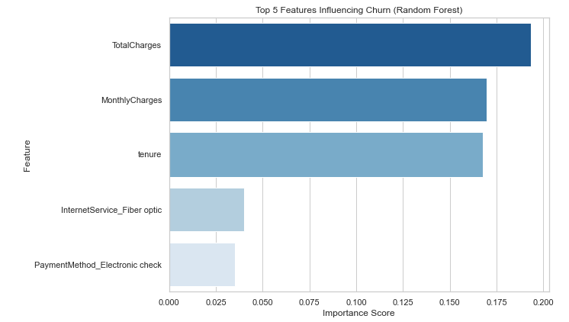
Top Factors Driving Churn
What This Means
Financial Signals Dominate
TotalCharges, MonthlyCharges and Tenure account for over 50% of predictive power combined
Fiber Optic = High Risk
Premium internet subscribers churn at 42% — value perception must be addressed
Payment Method Matters
Electronic check payers are more likely to churn than customers on automatic payment
Notes:
Explain these features came from the Random Forest model. Emphasise that financial variables dominate — customers who pay more and are newer are at highest risk.

Slide 8
Power BI Dashboard Highlights
8 interactive visuals built in Microsoft Power BI Desktop:
Churn Rate Card
Customers Card
Month-to-Month
Fiber Optic Risk
26.58%
7,032
42.71%
0.42
Retention Pie
Risk Charge Band
Churn Drivers
Churn by Tenure
73.4%
70-90
Top 5
Trend
Notes:
Reference your actual Power BI dashboard here. You can show the live file or PDF export during your presentation.

Slide 9
Business Recommendations
01
Incentivise Long-Term Contracts
Offer discounts and loyalty rewards to convert month-to-month customers to annual contracts
02
Enhanced Customer Onboarding
Deploy structured onboarding for new customers — churn peaks in the first 20 months
03
Review High-Tier Pricing
Customers in the $70-90 band feel underserved — improve value or offer targeted discounts
04
Investigate Fiber Optic Quality
Fiber Optic churns at 42% — survey customers and review service reliability and pricing
05
Deploy Model in CRM System
Use the 78.68% accuracy model to generate monthly churn risk scores for proactive outreach
Notes:
Go through each recommendation. Tie each one back to a specific finding from your EDA or model results.

Slide 10
Conclusion &
Key Takeaways
78.68%
Accuracy
0.83
7,032 customer records cleaned and fully prepared
AUC Score
Contract type, tenure and charges identified as key drivers
7,032
Logistic Regression: 78.68% accuracy, AUC of 0.83
Customers
Power BI dashboard with 8 business-ready visuals
5
5 data-backed recommendations for reducing churn
Recommendations
Notes:
Wrap up by summarising what was achieved. Thank your mentor and the 3MTT programme. Invite questions.

